Slide 1
Crash Course in Irish History
Objectives:
Who are the key players in Irish history?
What are the defining struggles of the Irish people?
What patterns emerge when we look at 500+ years of Irish history?
How might Irish history impact Irish writers and people writing about Ireland?

Slide 2
What do we know about Ireland?
What prior knowledge of Ireland do you have?
What facts stand out from your encyclopedia reading?
How is Ireland represented in the travel literature?

Slide 3
Irish literature = English literature?
Notes:
Central question when studying writing by Irish authors, and to get to the bottom of this we have to understand the complicated relationship between Ireland and England (and Scotland)

Slide 4
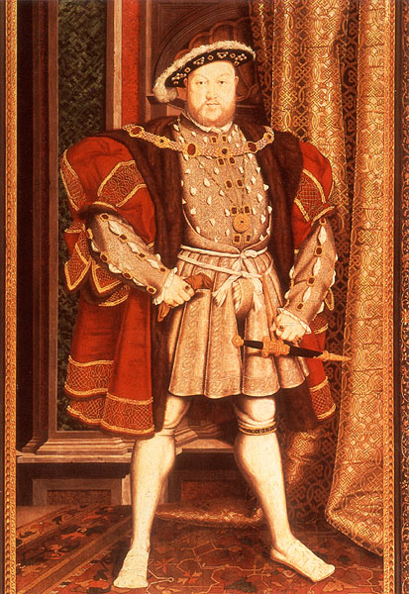
Renaissance
King Henry VIII
King of England
1509-47
Declared himself king of
Ireland in 1541
Declared himself head of Church of England
England = Anglican (Protestant)
Ireland = Catholic
Notes:
What do we know about Henry VII?
Religious divide begins to crystalize

Slide 5
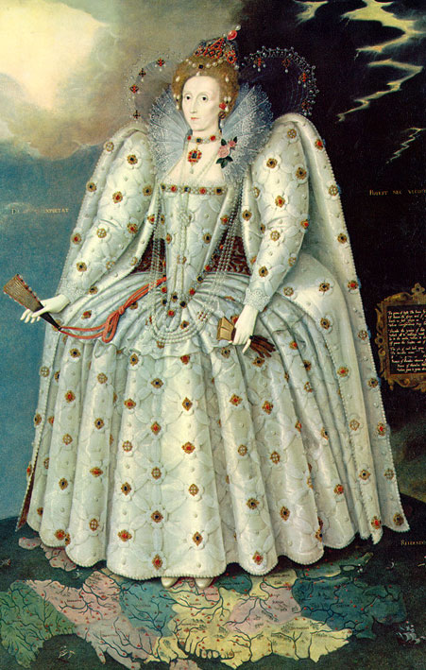
Queen Elizabeth and Colonization
Queen Elizabeth I
Queen of England 1558-1603.
Begins plantation of Ireland
Flight of the Earls, 1607
Notes:
Beginnings of colonial experiment and Irish dispossession
Plantation: systematic removal of native Irish people from their land and replacing them with wealthy English people, in the hope of spreading the Protestant religion as well as English customs and laws.
Old Gaelic order leaves, vacuum of high culture and establishing Irish colleges throughout continental Europe

Slide 6
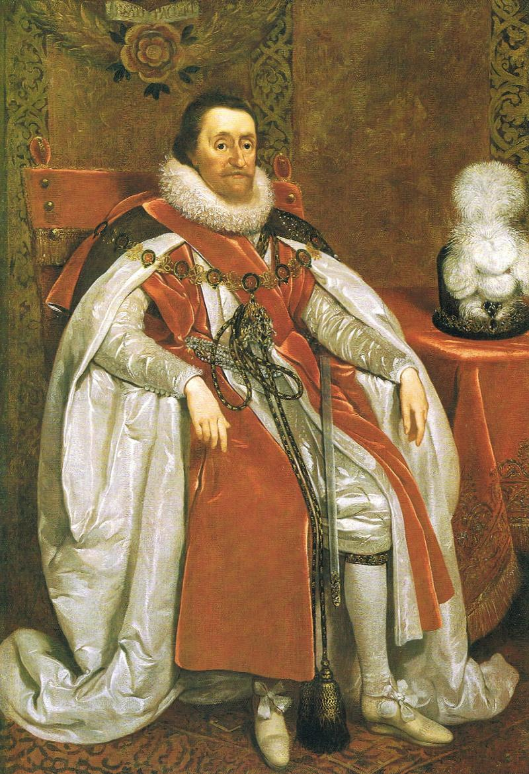
James I and Ulster
James IV of Scotland becomes James I of England, uniting the two kingdoms under one monarch (1603-1649)
Begins Plantation of Ulster, Northern Ireland in 1610.

Slide 7
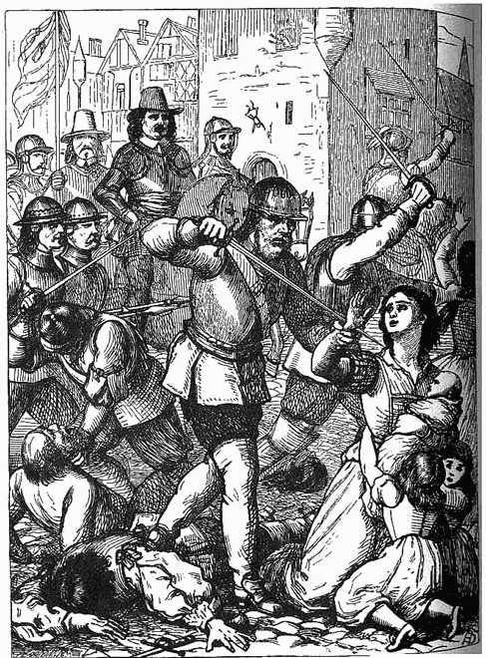
Oliver Cromwell
Oliver Cromwell and his army landed at Dublin in 1649. His troops killed 2,000 men and a majority of Irish lands were divided among the English soldiers.
Notes:
“heroes of English history are the villains of Irish history”

Slide 9
Strife and Rebellion
James II (1685-1688): Abdicated and fled to Ireland in 1688
King William of Orange (1689-1702): Followed James II to Ireland to put down the Catholic Jacobite Rebellion.
Battle of the Boyne 1690
Notes:
Up to date with beginnings of our course.
As we know, after the death of Cromwell, Charles II was restored to the thrown. After his death he was succeeded by Catholic James II. When James had a Catholic son, the Protestant William of Orange invaded England.
James II fled to Ireland because of its Catholic sympathies, where he was followed by William of Orange
Battle of the Boyne: the two sides met. William wins, weakening James’s claim to the thrown, and securing a victory in Ireland for the Protestant ruling class.
Still celebrated by protestants in Ireland, in the North.

Slide 10
Penal Laws: 1695
Catholics forbidden from:
Holding political office
Holding professional positions (lawyers, etc.)
Intermarriage with Protestants
Owning guns
Patrilineal inheritance
Buying land
Owning a horse of greater value than £5

Slide 11
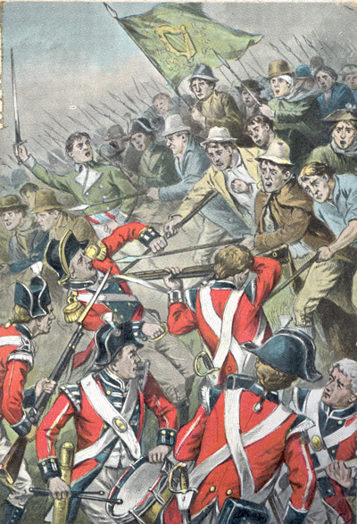
1798 Rebellion
Inspired by the French Revolution, the United Irishmen, lead by Wolfe Tone, rose against British authority in Ireland.
Notes:
Important for Yeats…
Wolfe Tone and his fellow revolutionaries have an important place in Irish cultural memory… seen as the modern beginnings of an ancient tradition of Irish rebels and martyrs
Ballads, folk songs Yeats draws on

Slide 12
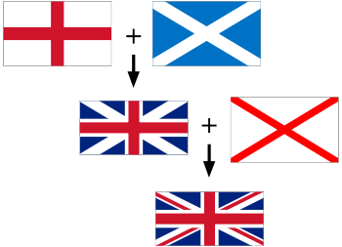
1801 Act of Union
Irish Parliament dissolved
United Kingdom:
Notes:
1798 Rebellion failed, lack of communication between the leaders
England + Scotland
+
Great Britain + Ireland
= UK

Slide 13
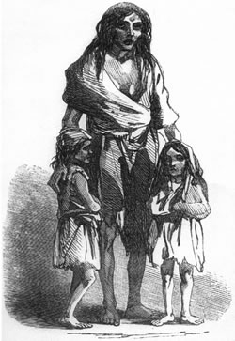
Famine, 1845-1850
A massive blight hit in 1845 destroying most of the potato crop for five years in a row.
One million deaths from starvation and disease.
One million people emigrate
Failure of English government
Notes:
(highlight last two points)

Slide 14
Key Revolutionary Figures
1829: Daniel O’Connell, “The Liberator,”
Successful, nonviolent democratic political action
Repeals Penal Laws
1890s: Charles Stewart Parnell
Advocate for Home Rule
Unites Irish parliament
Downfall and divorce
Notes:
O’Connell: “Catholic emancipation”, campaigned for repeal of Act of Union. Influence on nonviolent protestors around the world
Parnell: advocate for home rule aka self government, was really getting somewhere :
Downfall: impact on Yeats: increasing disenchantment with the Irish public and their middle class values

Slide 15
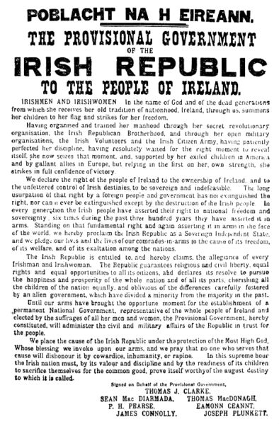
Easter Monday, 1916
Irish volunteers led by the Irish Republican Brotherhood occupied the General Post Office in Dublin and declared Irish Independence.
Padraig Pearse and 6 others sign Proclamation
Leaders were teachers, poets, activists
Notes:
*99 years ago TODAY*

Slide 16
Easter 1916: Consequences
14 leaders executed
Shift in public opinion
Martyrdom
Yeats, “Easter 1916”
“All changed, changed utterly:
A terrible beauty is born.”
Notes:
Impact for Yeats: was in Paris when he heard the news, involved many of his friends, crystallized his ambivalent feelings about politics, and for a period of time he became a more enthusiastic supporter of political action and activism, a cause which he had previously maintained a degree of skepticism about

Slide 17
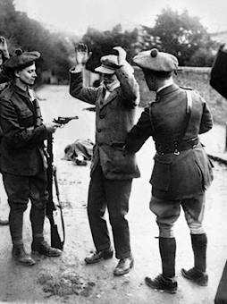
Irish War for Independence 1919-1921
aka “Anglo-Irish War”
Michael Collins, founder of the IRA
Éamon de Valera President
Black and Tans
Casualties: ~2,000
Notes:
Naming of Wars
Black and Tans returning WWI vets
Casualties almost entirely civilians

Slide 18
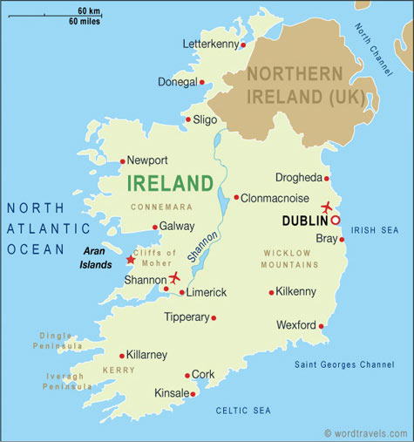
Treaty and Partition
Anglo-Irish Treaty, 1921
Terms:
Ireland declared a Free State, with allegiance to the UK.
Irish negotiators agree to the partition of the north.
Some Irish politicians protest Partition and the declaration of allegiance.
Civil War breaks out between Pro-Treaty and Anti-Treaty factions in Ireland.
Notes:
“uneasy peace”

Slide 19
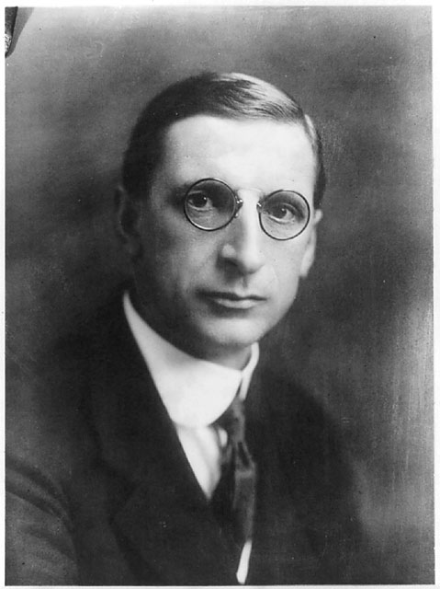
Irish Civil War 1922-1923
Pro Treaty:
Michael Collins
Anti Treaty:
Éamon de Valera

Slide 20
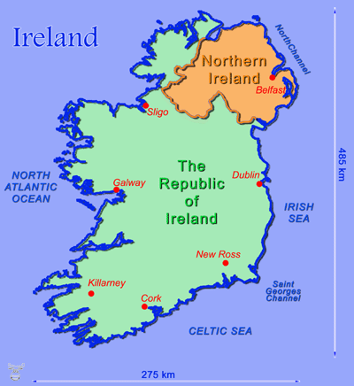
Religion and the Conflict :
Ireland is divided into 32 counties,
26 form Southern Ireland (Eire)
6 form Northern Ireland (Ulster)
In the Republic of Ireland,
95% of the population
identify as Catholic
In Northern Ireland,
60% of the population
identify as Protestant,
40% as Catholic

Slide 21
The Troubles…
Notes:
The majority of the 20th Century saw ongoing sectarian conflict, especially In the north. protestant loyalists and catholic republicans
“The Troubles”
Protestants fighting Catholics
English fighting Irish

Slide 22
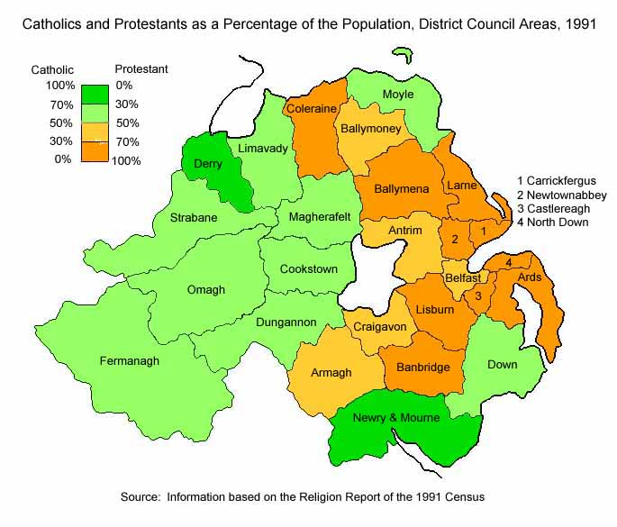
Map of Religious Divisions

Slide 23
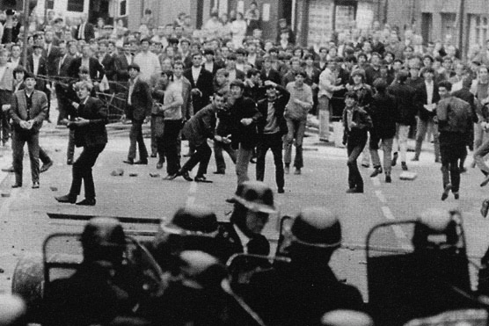
Battle of the Bogside, 1969

Slide 24
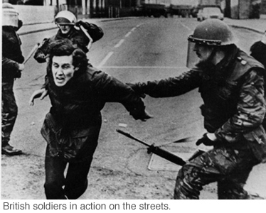
British Troops arrive, Aug. 14 1969

Slide 25
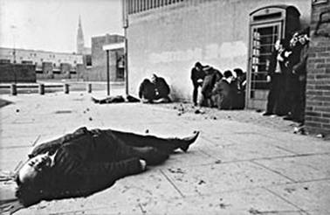
Bloody Sunday, 1972

Slide 26
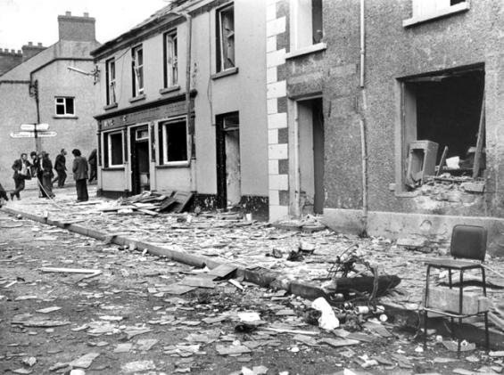
IRA Car Bomb, 1972

Slide 27
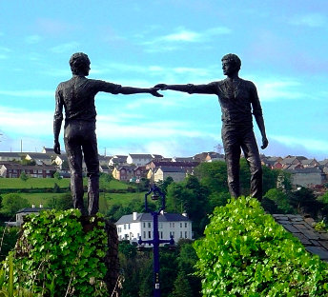
Peace Sculpture, Northern Ireland

Slide 28
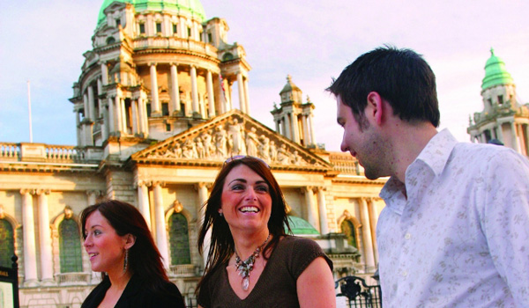
Belfast, Northern Ireland 2005

Slide 29
Conclusions:
Objectives:
Who are the key players in Irish history?
What are the defining struggles of the Irish people?
What patterns emerge when we look at 500+ years of Irish history?
How might Irish history impact Irish writers and people writing about Ireland?

Slide 30
Group Work
Research history and tourism of one of Ireland’s provinces
Group 1: Connacht
Group 2: Leinster
Group 3: Munster
Group 4: Ulster
What important historical events took place in your province?
What do the tourism websites for your province highlight? In other words, why are people visiting your province?

